Slide 1
2D object creation and applying transformations
Dr. Sk. Md. Masudul Ahsan
Professor
Dept. of CSE, KUET
Md. Tajmilur Rahman
Lecturer
Dept. of CSE, KUET

Slide 2
What you will see today
OpenGL Primitives
Point primitives
Line primitives
Triangle primitives
2D Object Transformation

Slide 3
OpenGL Primitives
The term Primitive in OpenGL refers to the interpretation scheme used by OpenGL to determine what a stream of vertices represents when being rendered e.g. "GL_POINTS".
In OpenGL, an object is made up of geometric primitives such as triangle, quad, line segment and point. A primitive is made up of one or more vertices.

Slide 4
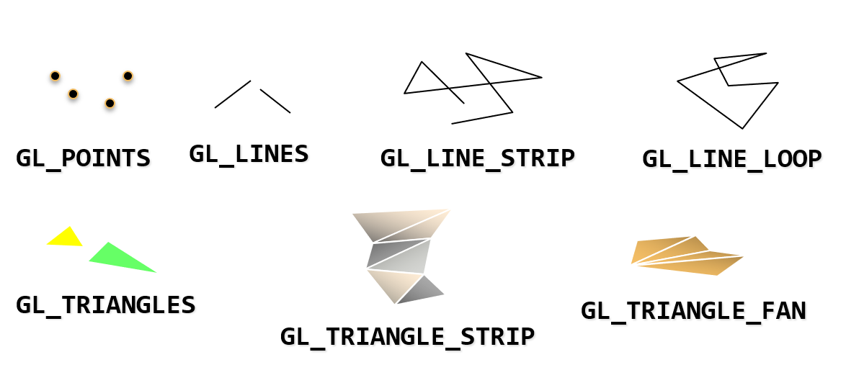
OpenGL Primitives

Slide 5
OpenGL Primitives : Point primitives
There is only one kind of point primitive: GL_POINTS. This will cause OpenGL to interpret each individual vertex in the stream as a point.

Slide 6
OpenGL Primitives : Line primitives
There are 3 kinds of line primitives, based on different interpretations of a vertex stream.
GL_LINES:
Vertices 0 and 1 are considered a line.
Vertices 2 and 3 are considered a line, and so on.
If the user specifies a non-even number of vertices, then the extra vertex is ignored.

Slide 7
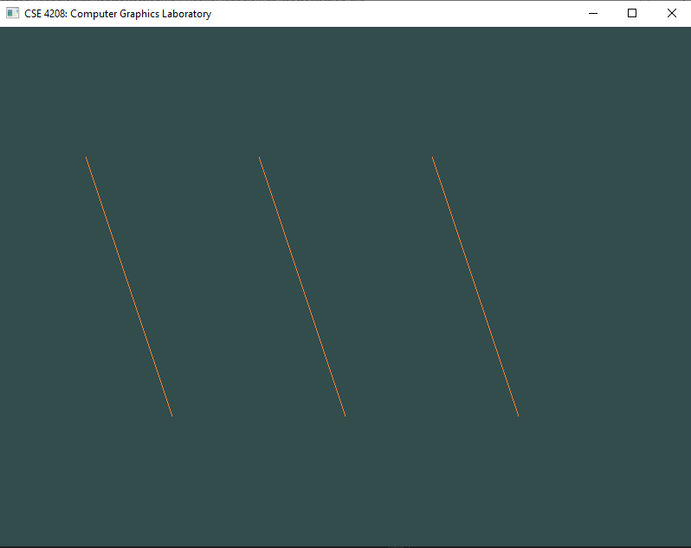
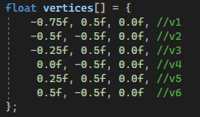
OpenGL Primitives : Line primitives
v1
v3
v5
v2
v4
v6

Slide 8
OpenGL Primitives : Line primitives
GL_LINE_STRIP:
The adjacent vertices are considered lines.
Thus, if you pass n vertices, you will get n-1 lines.
If the user only specifies 1 vertex, the drawing command is ignored.

Slide 9
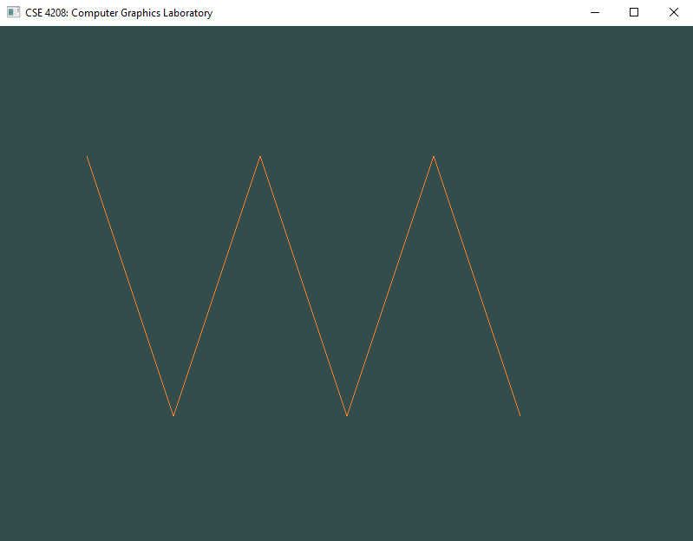
OpenGL Primitives : Line primitives
v1
v3
v5
v2
v4
v6

Slide 10
OpenGL Primitives : Line primitives
GL_LINE_LOOP: As line strips, except that the first and last vertices are also used as a line. Thus, you get n lines for n input vertices. If the user only specifies 1 vertex, the drawing command is ignored. The line between the first and last vertices happens after all of the previous lines in the sequence.

Slide 11
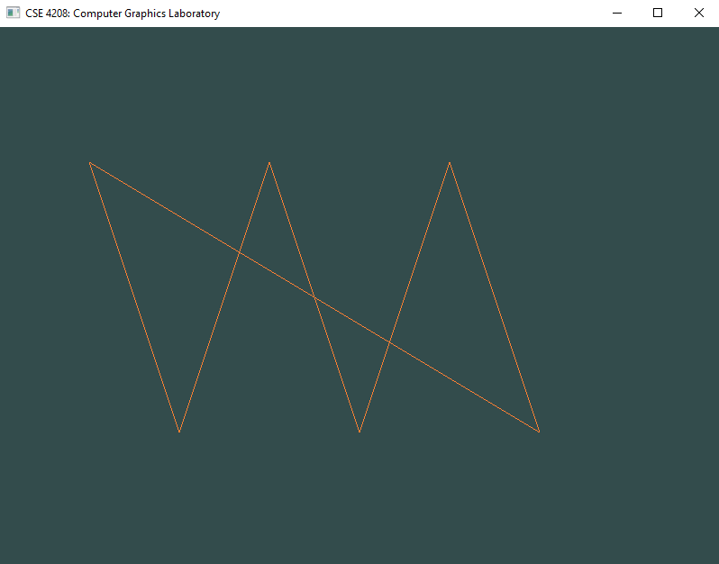
OpenGL Primitives : Line primitives
v1
v3
v5
v2
v4
v6

Slide 12
OpenGL Primitives : Triangle primitives
A triangle is a primitive formed by 3 vertices. It is the 2D shape with the smallest number of vertices, so renderers are typically designed to render them. Since it is created from only 3 vertices, it is also guaranteed to be planar.
There are 3 kinds of triangle primitives, based again on different interpretations of the vertex stream:
GL_TRIANGLES: Vertices 0, 1, and 2 form a triangle. Vertices 3, 4, and 5 form a triangle. And so on.

Slide 13

OpenGL Primitives : Triangle primitives
v1
v3
v5
v2
v4
v6

Slide 14
OpenGL Primitives : Triangle primitives
GL_TRIANGLE_STRIP:
Every group of 3 adjacent vertices forms a triangle. The face direction of the strip is determined by the winding of the first triangle. Each successive triangle will have its effective face order reversed, so the system compensates for that by testing it in the opposite way. A vertex stream of n length will generate n-2 triangles.

Slide 15
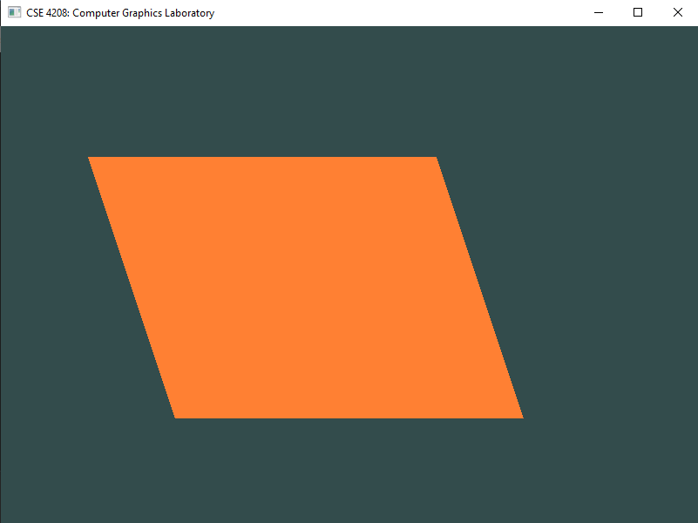
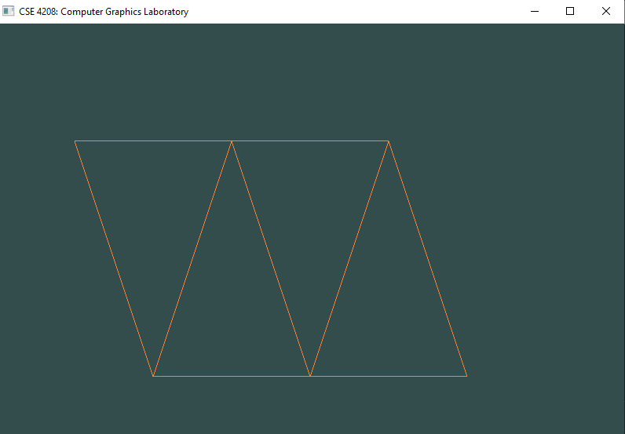
OpenGL Primitives : Triangle primitives
v1
v3
v5
v1
v3
v5
v2
v4
v6
v2
v4
v6

Slide 16
OpenGL Primitives : Triangle primitives
GL_TRIANGLE_FAN:
The first vertex is always held fixed. From there on, every group of 2 adjacent vertices form a triangle with the first. So with a vertex stream, you get a list of triangles like so: (0, 1, 2) (0, 2, 3), (0, 3, 4), etc. A vertex stream of n length will generate n-2 triangles.

Slide 17
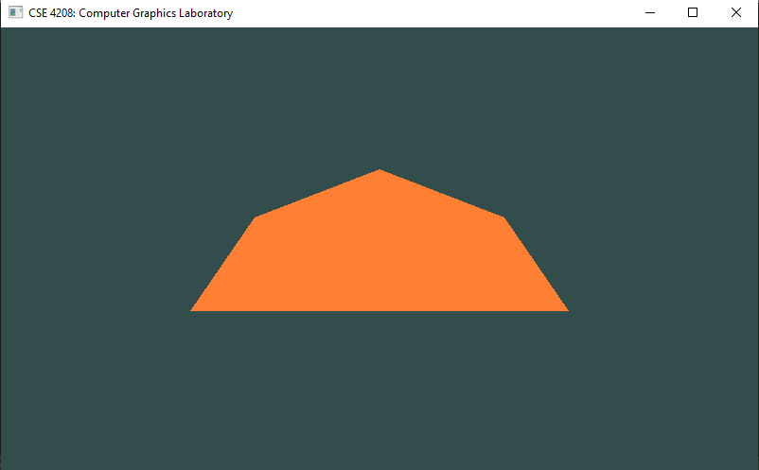
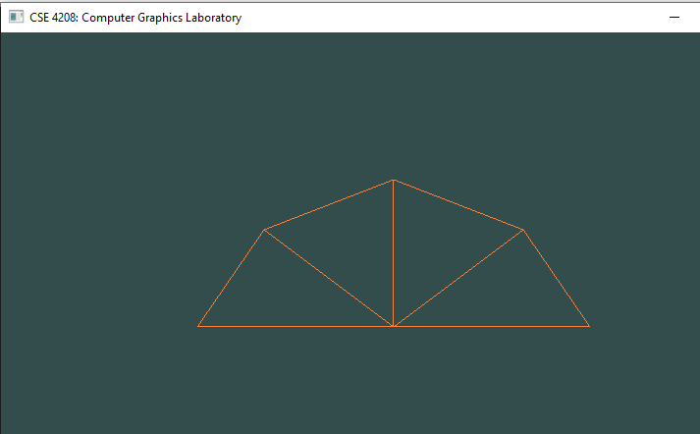
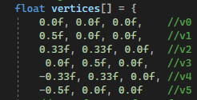
OpenGL Primitives : Triangle primitives
v3
v3
v4
v2
v4
v2
v5
v0
v1
v5
v0
v1

Slide 18
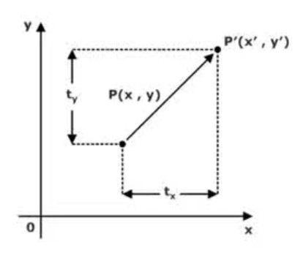
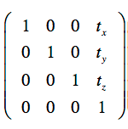
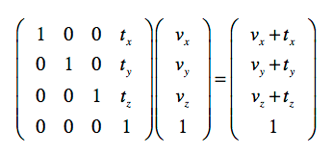
2D Transformation : Translation
From the above figure, we can write that:
X’ = X + t_{x}
Y’ = Y + t_{y}
4*4 Translation Matrix
tz = 0 Since, we are considering 2D translation

Slide 19
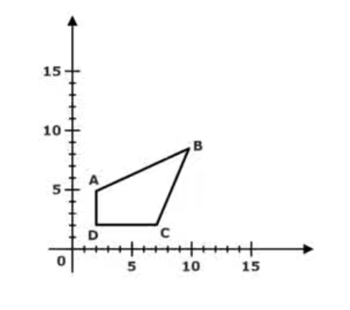
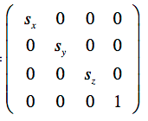
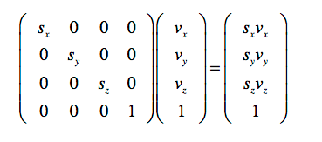
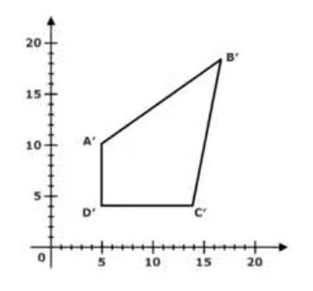
2D Transformation : Scaling
4*4 Scaling Matrix
Sz = 1 Since, we are considering 2D translation
X' = X . S_{X} and Y' = Y . S_{Y}

Slide 20
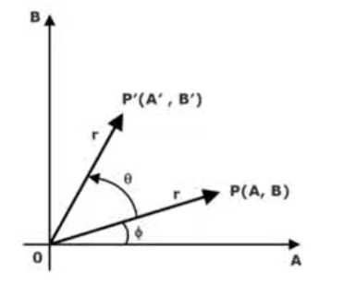
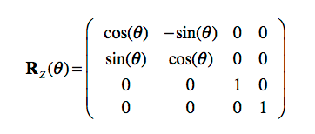
2D Transformation : Rotation

Slide 21

Lab Task
Draw the send message icon by 2 triangles:

Slide 22
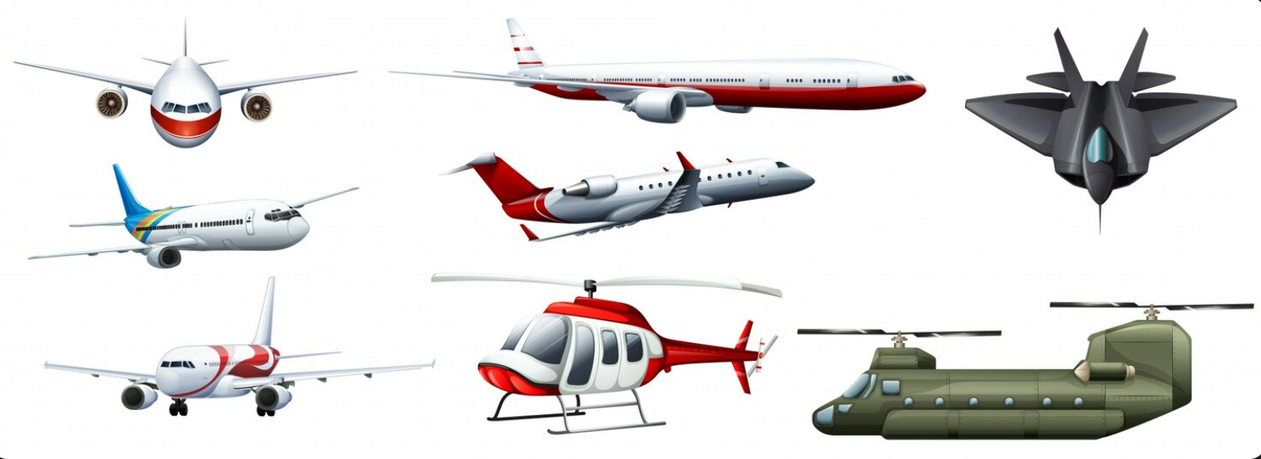
Assignment (B)
Draw a 2D air vehicles

Slide 23

Assignment (A1)
Draw a 2D vehicles

Slide 24
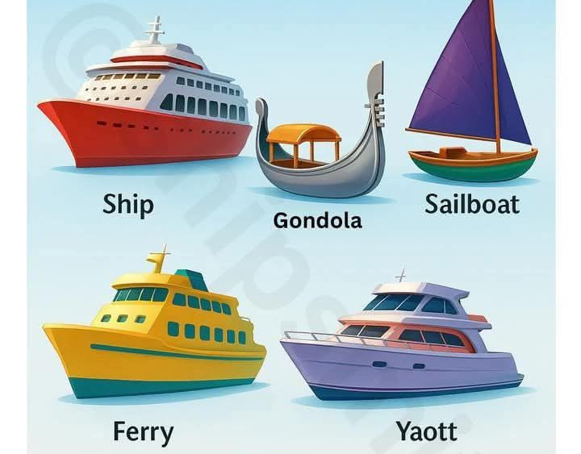
Assignment (A2)
Draw a 2D water vehicles

Slide 25
References
https://www.khronos.org/opengl/wiki/Primitive
https://www.brainvoyager.com/bv/doc/UsersGuide/CoordsAndTransforms/SpatialTransformationMatrices.html
https://byjusexamprep.com/transformation-in-computer-graphics-i
https://www.euclideanspace.com/maths/geometry/affine/matrix4x4/index.htm

